Slide 1

The Impact of the Maine Indian Claims Settlement Act’s Restrictions on the Application of Federal Indian Policy to the Wabanaki Nations
Prof. Joe Kalt
The Harvard Project on American Indian Economic Development
John F. Kennedy School of Government
Harvard University
March 9, 2023
The Harvard Project on American Indian Economic Development
`

Slide 2
Overview of Findings
MICSA blocks full application of federal Self-Determination policy in Maine
Compared to non-Maine tribes, all four Wabanaki Nations lag severely in economic development
MICSA is the central cause of the Wabanakis’ underdevelopment
Wabanaki development would benefit Maine’s Wabanaki and non-Wabanaki citizens

Slide 3
Some Background on the Impacts of Federal Self-Determination Policy
Outside of Maine, there’s a thirty-year economic boom going on in Indian Country
Outside of Maine since 1989, Indian incomes on reservations have grown 3½ times faster than in the US as a whole
Outside of Maine, reservation poverty has been cut almost in half
Outside of Maine, more and more tribes are becoming the economic and municipal service engines of their regions

Slide 4
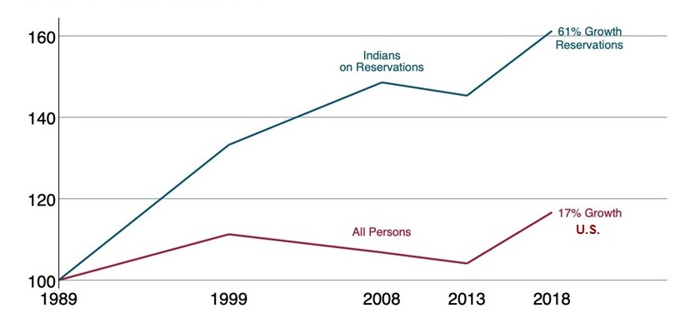
The Economic Boom in Indian Country
Growth in Real (inflation-adjusted) Per Capita Income:
Indian Country v. the U.S. as a Whole (1989=100)

Slide 5
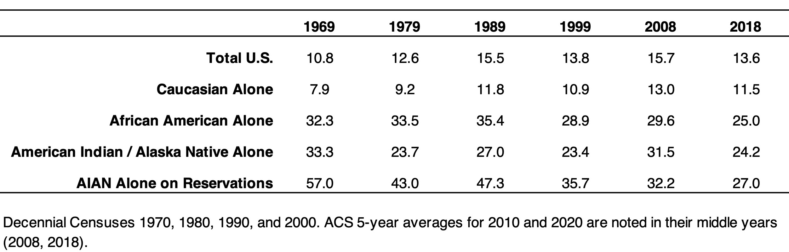
The Economic Boom in Indian Country: Poverty
And 2020 is at 23.4%
Families with Children Living in Poverty
Indian Country v. the U.S. as a Whole

Slide 6
Why the Strong Economic Growth Outside of Maine?
It’s not all about gaming

Slide 7
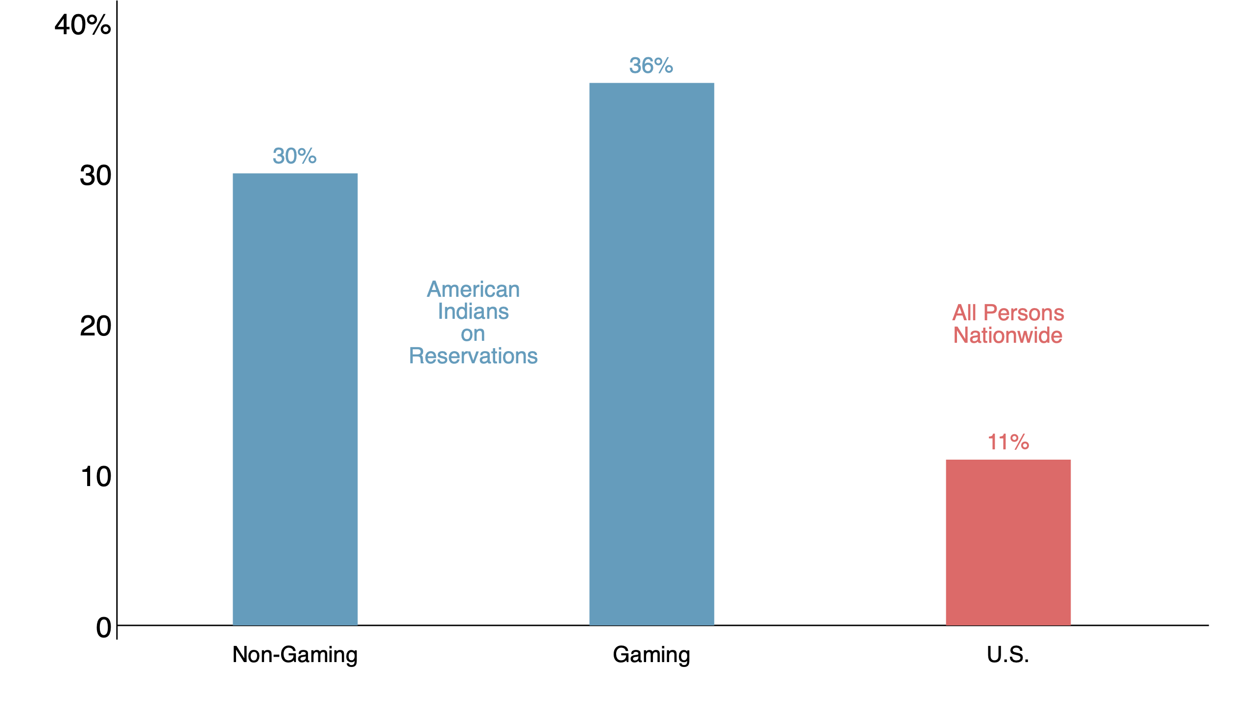
Gaming and Non-Gaming Reservation Economies Grew Rapidly in the 1990s
Growth in Real (inflation-adjusted) Per Capita Income:
Indian Country v. the U.S. as a Whole, 1989-99

Slide 8
There’s Much More than Gaming Underlying Tribal Economic Development Outside Maine
Hotels, restaurants, golf courses, fishing and hunting, event centers, spas, bowling alleys, and museums diversify the tourism sector
Tribal government clinics and services earn revenue from outside tribal economies
Construction firms, mines, distilleries, convenience stores, housing, manufacturing companies, farms, fish processing plants, financial services, fuel distribution, grocery stores, and more

Slide 9
Why the Strong Economic Growth Outside of Maine?
It’s not all about gaming
It’s not about federal spending

Slide 10
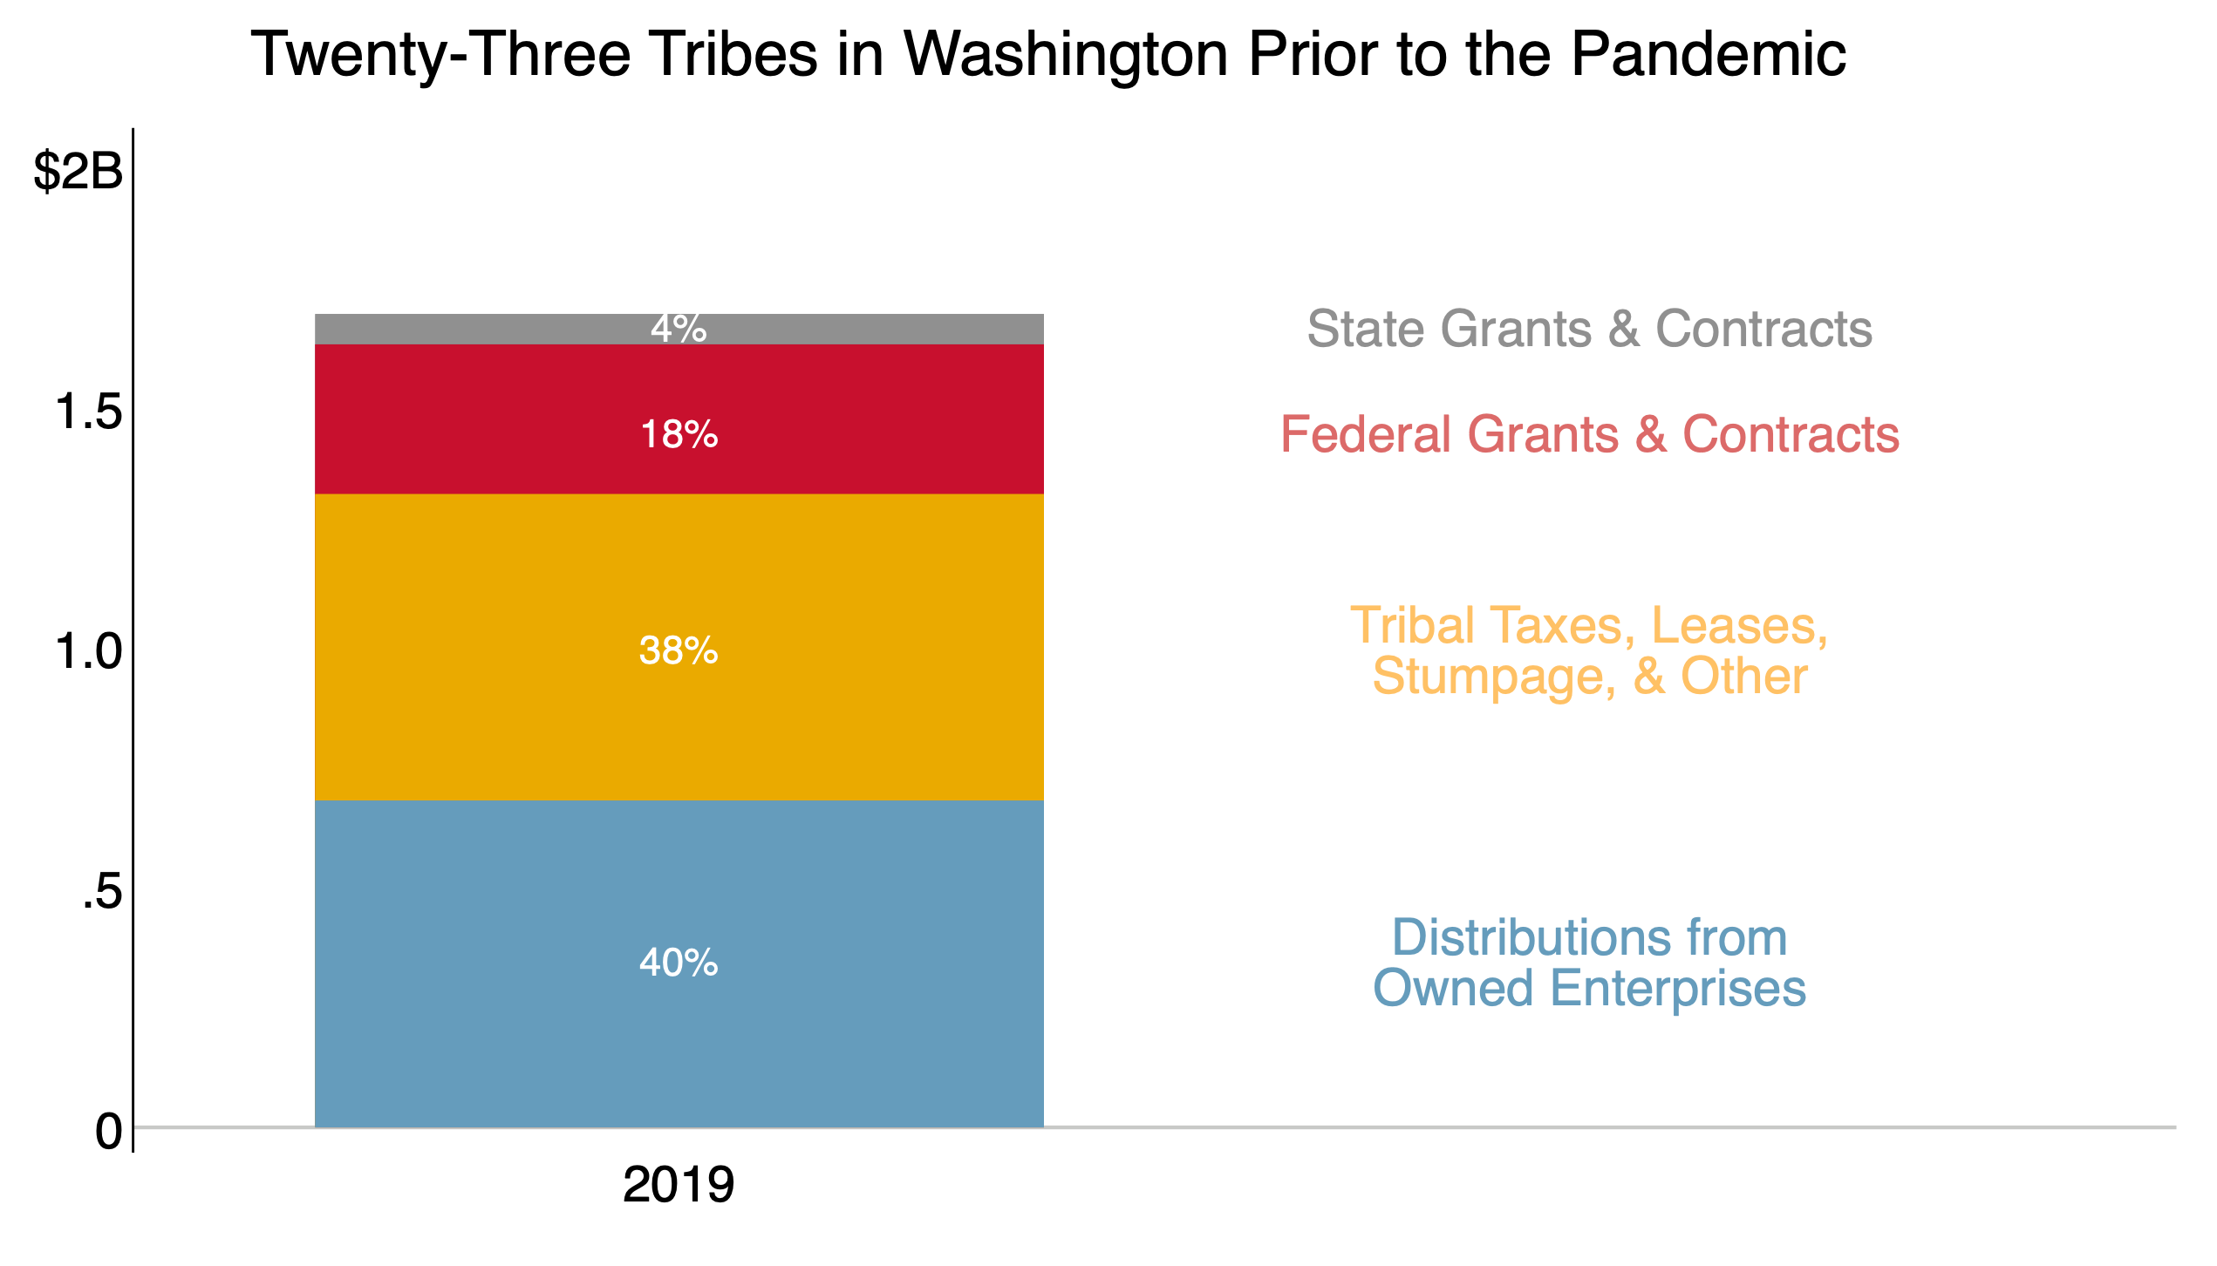
U.S. Tribes Are Increasingly Fiscally Independent
Tribal Revenue from Self-Government

Slide 11
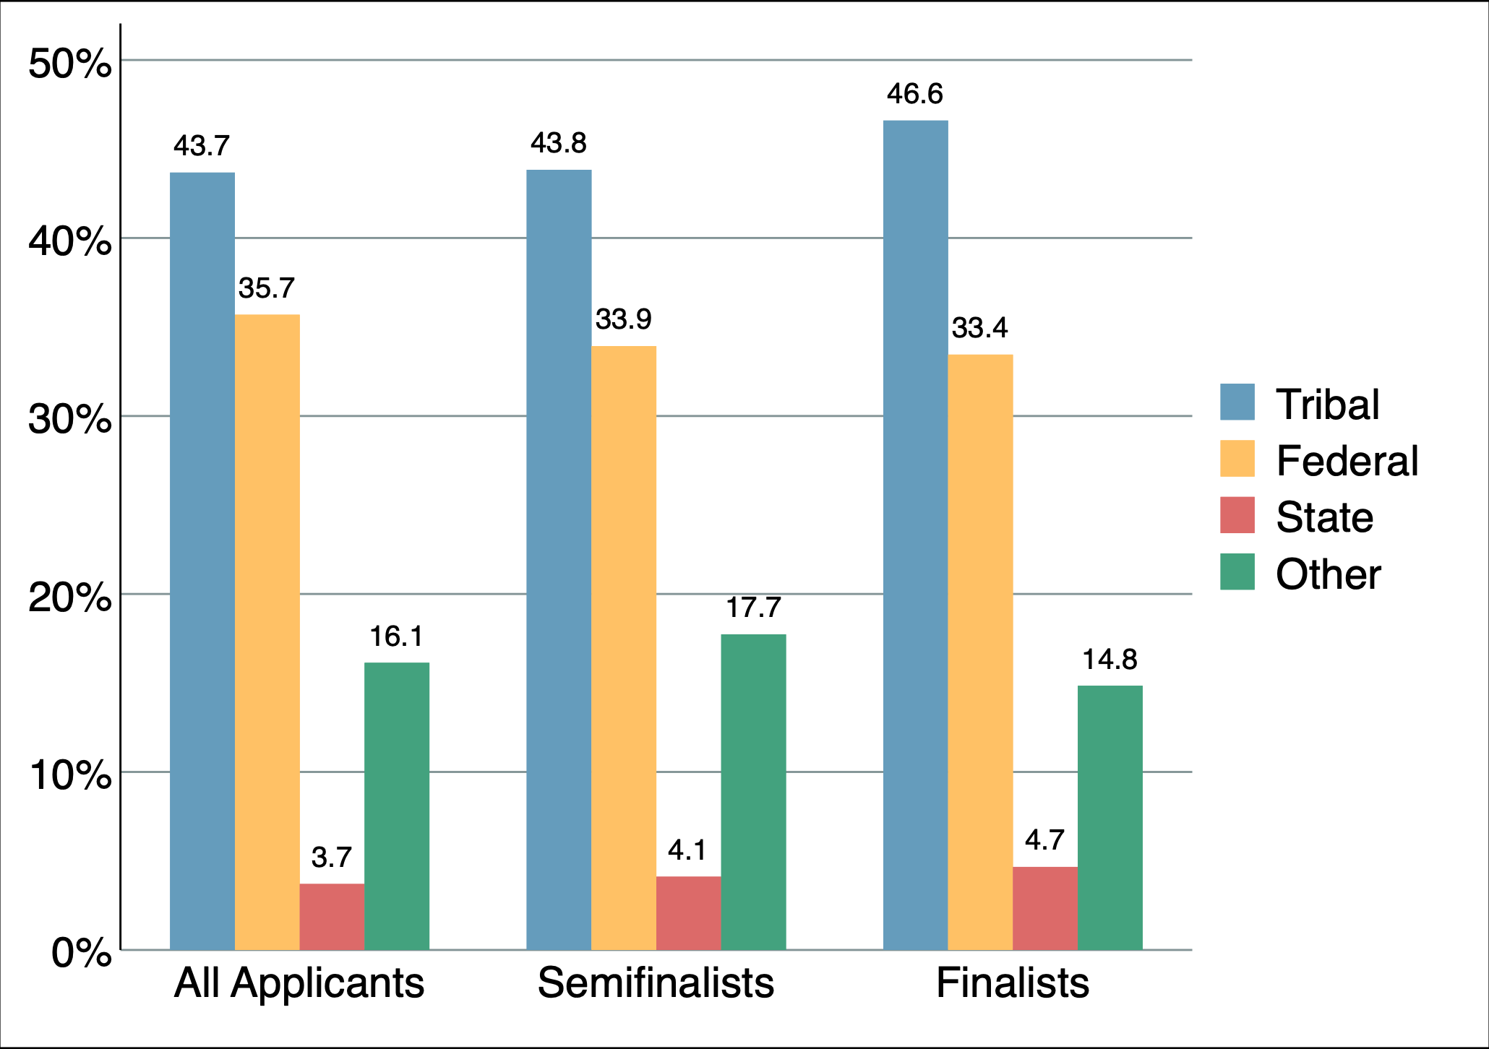
Funding of Successful Tribal Government Programs
Funding Sources for a Sample of
925 High-Performing Tribal Programs

Slide 12
Why the Strong Economic Growth Outside of Maine?
It’s not all about gaming
It’s not about federal spending
It is all – or at least mostly – about the federal policy shift to tribal self-government

Slide 13
Research on the Effects of Federal Policies of Self-Determination through Self-Government
Tribes that took over timber operations on their reservations produced higher prices per log, greater income, higher productivity
Tribes that took over health care produced shorter waiting times, higher patient satisfaction
Tribes that took over financial management produced higher ROIs
Tribes that took over housing had units that were more solvent and in better repair
Tribes that took over education improved scores and graduation rates
Tribes excluded from self-government have languished economically
  The “event” of self-governance in the late 1980s after decades of stagnation
  Alaska, Canada

Slide 14
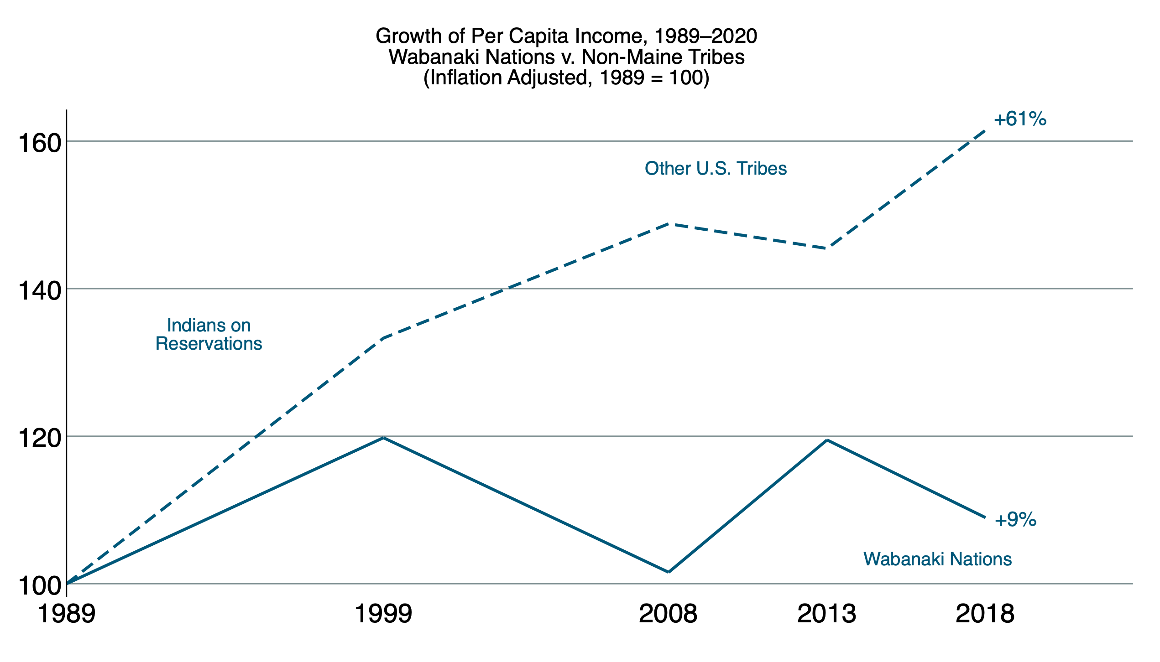
The Wabanakis Have Not Been Able to Keep Up
Real Income Growth:
Wabanaki Nations v. Non-Maine Tribes
Real (Inflation-adjusted) Income; 1989 = 100

Slide 15
How Do the Wabanakis Compare
to the Rest of Maine?
Passamaquoddy

Slide 16
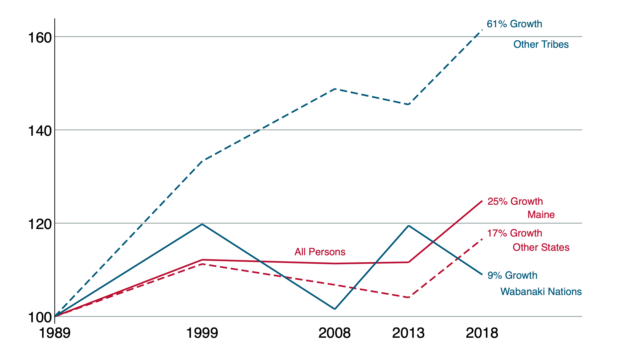
Maine’s Economy Is Not the Cause
Growth in Real (inflation-adjusted) Per Capita Income:
Wabanaki Nations v. the Other Tribes, Maine, & the U.S. as a Whole (1989=100)

Slide 17
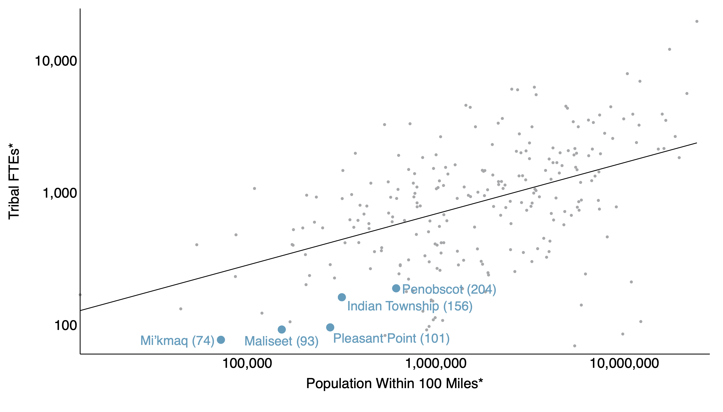
How Do the Wabanaki Nations Compare to Other Tribes of Similar Sizes & Locations?

Slide 18
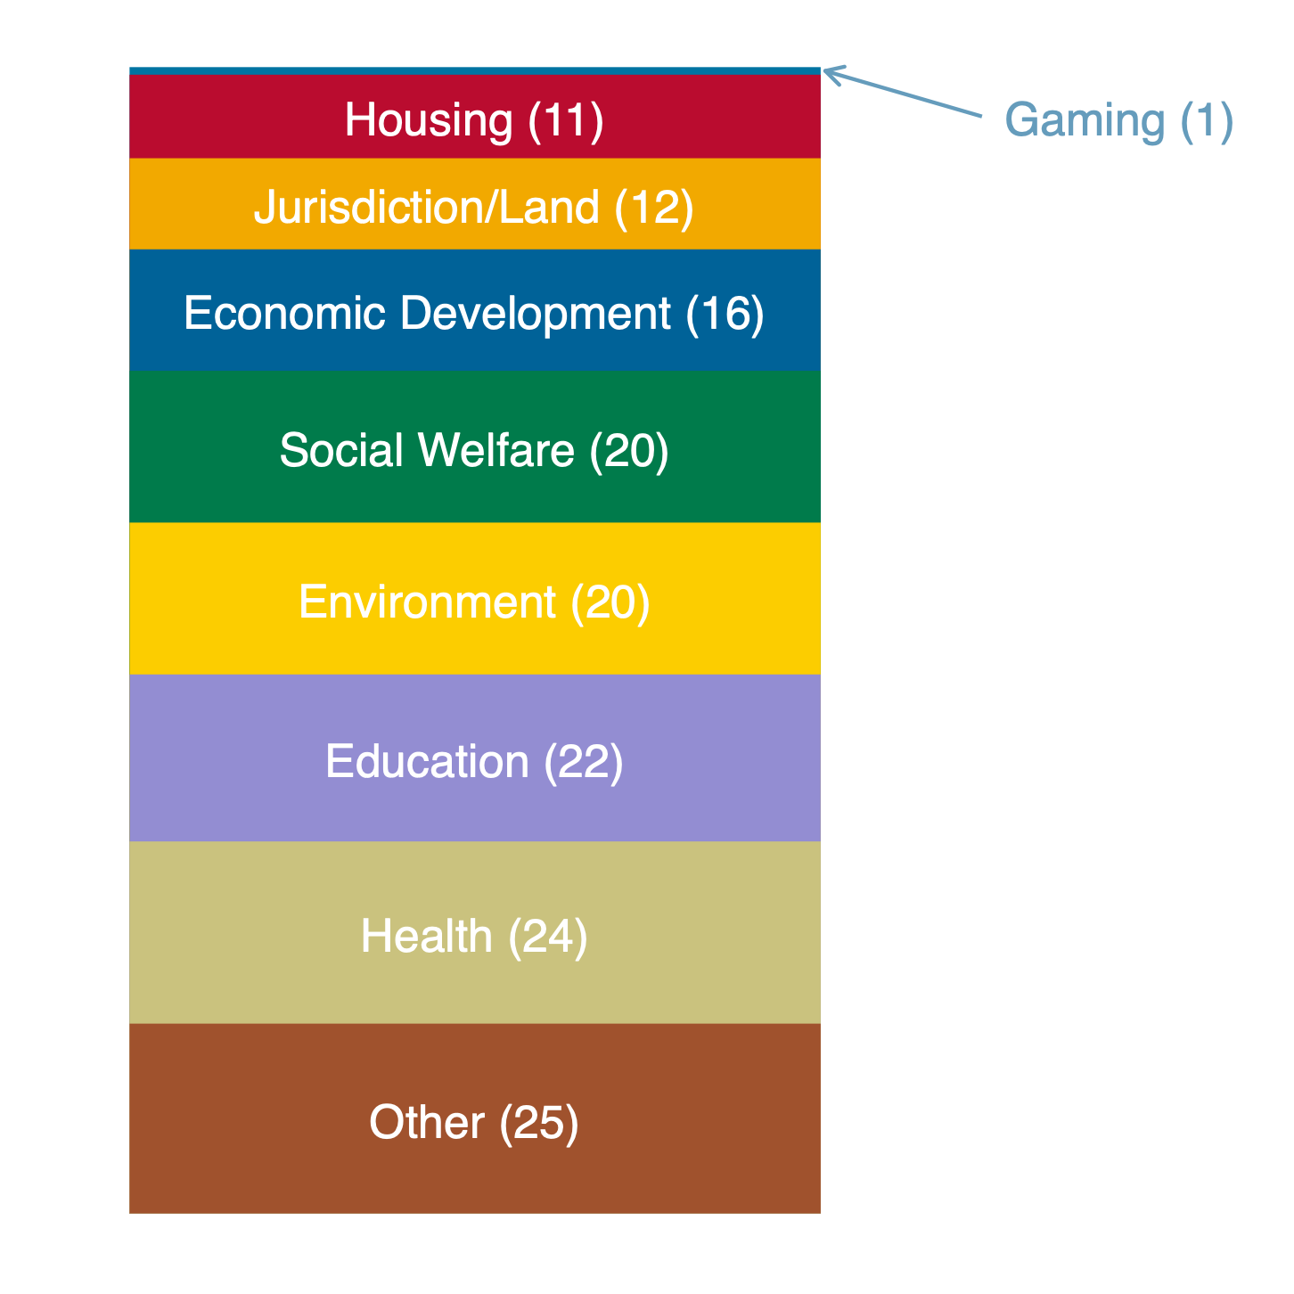
MICSA Cuts the Wabanaki Nations Off from Federal Self-Determination Policy
Unless the Wabanaki are explicitly included by Congress, Maine can block federal policies after 1980 if they “affect or preempt” Maine’s jurisdiction
The “affects or preempts” language gives Maine a low-cost veto over Wabanaki self-rule
  Uncertainty, costly conflict, expensive litigation
  Invisible effects: Tribes discouraged from hiring & investing in programs, so they don’t
  Result? Underdeveloped tribal governments
The impediment is not inhibited access to federal funding; it’s stunted development of tribal government
Principal Subject Matter of 151 Federal Indian Laws, 1980-2019

Slide 19
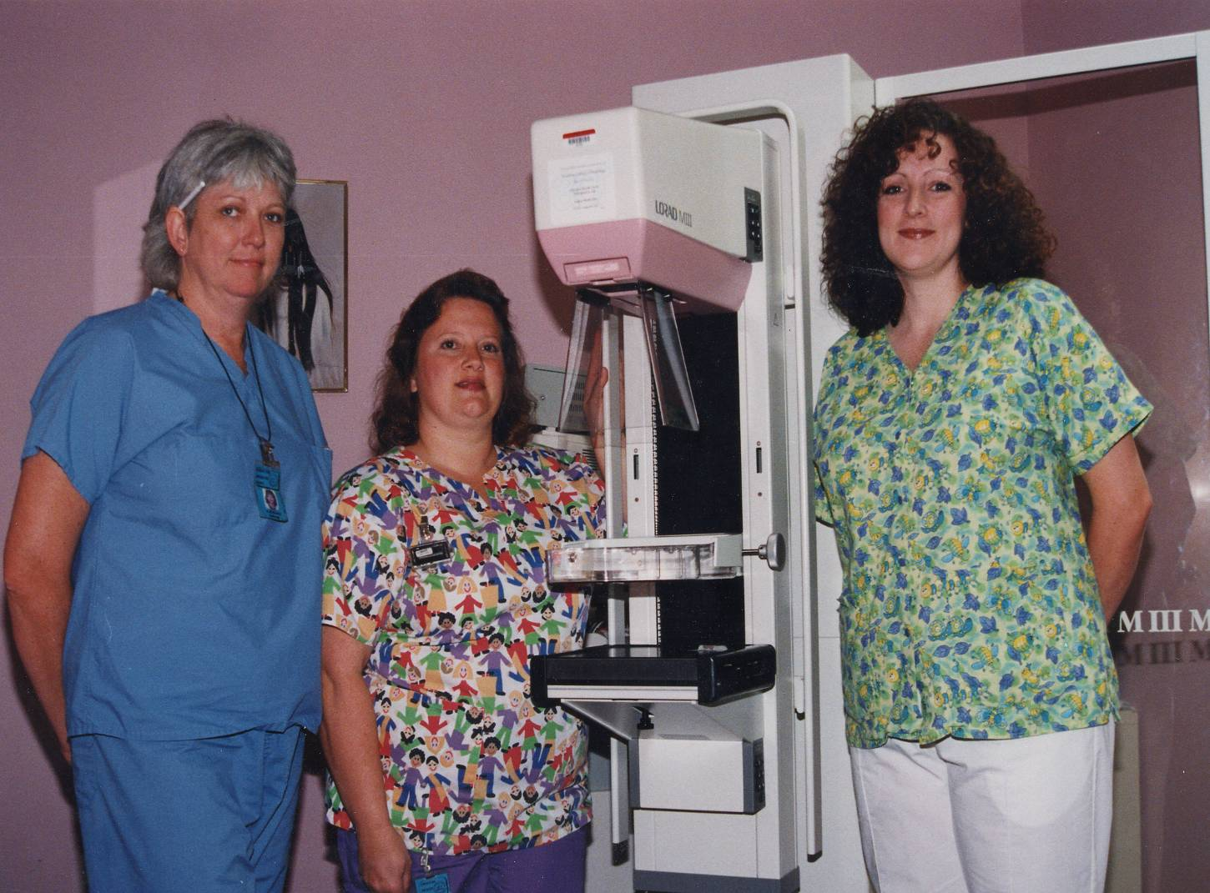
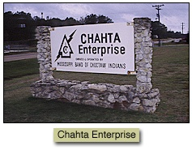


From Out of the Pine Forests of Rural Mississippi: Mississippi Choctaw

Slide 20

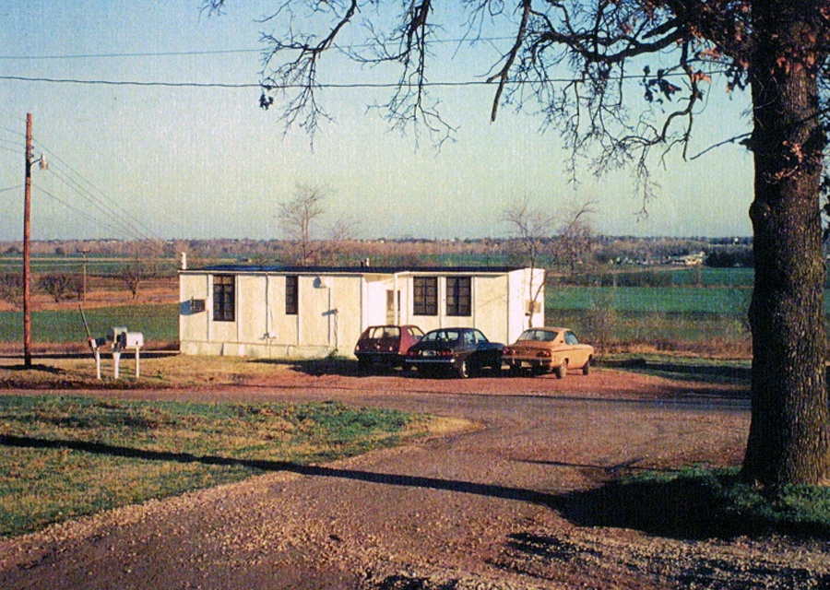

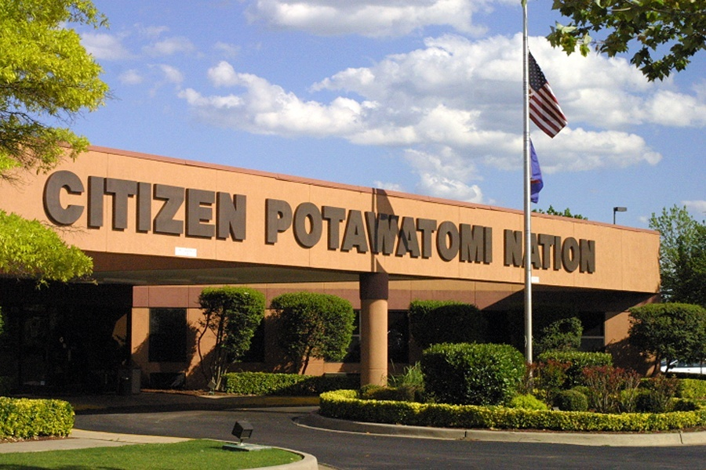
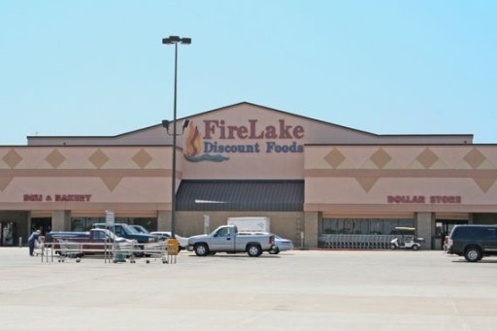
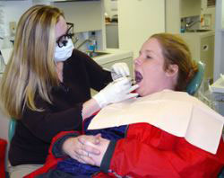
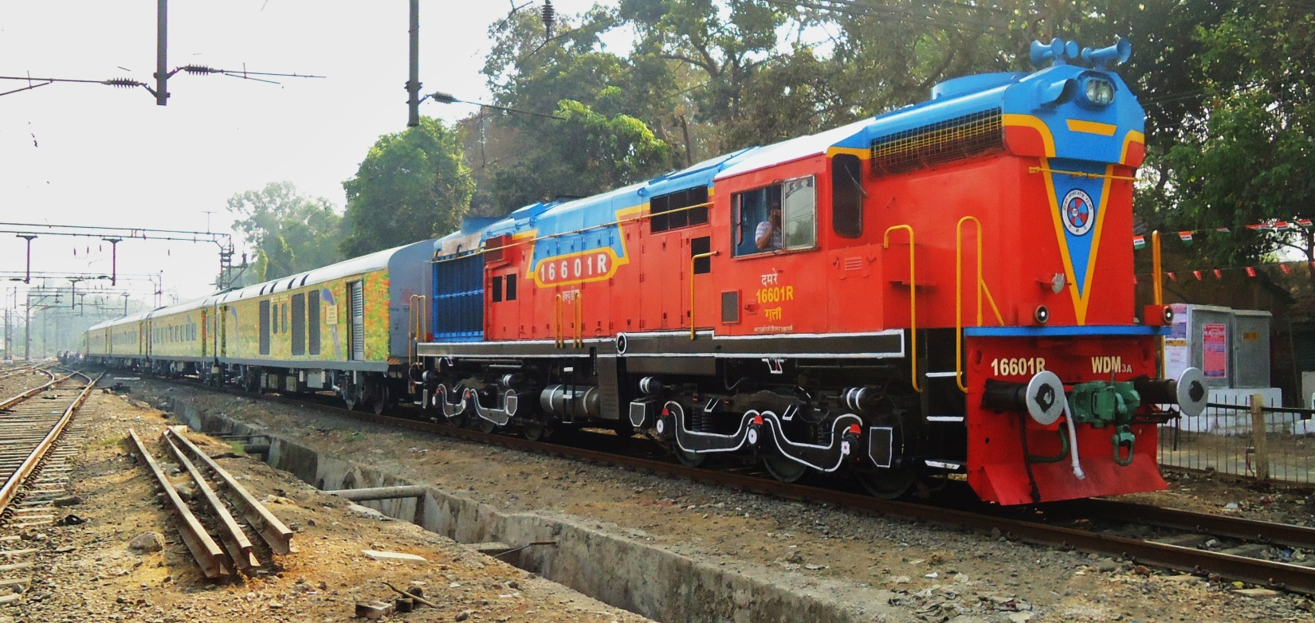
The Late 1970s…
2.5 Acres of Land
$500 in the Bank
This House Trailer

Slide 21
What Does a Fully Developed Tribal Government Look Like?
The Citizen Potawatomi Nation

Slide 22
A Sample Tribal Government
Constitution
Executive:
Chairman & Vice-Chairman
Secretary-Treasurer
Legislative:
X Elected members including the 3 Executives
Judicial:
Chief Justice
Chief Administrator Chief District Judge
Tribal Supreme Court
Tribal District Court
Rules & Government
Judiciary & Public Safety
Health & Human Services
Natural Resources
Education
Economic Development & Commerce
Committee of the Whole
Tribal Culture & Arts

Slide 23
Select Laws and Regulations
Election Code
Civil Code
Criminal Code
Tax Code
Traffic Code
Housing Code
Education Code
Commercial Code
Land Use Code
Environmental Protection Code
Disaster Management Plan
Alcohol and Tobacco Regulations
Gaming and Boxing Regulations
Labor and Employment Code
Juvenile and Child Welfare Code
Domestic Violence and Prevention of Domestic Abuse Code

Slide 24
Legal, Health, & Social Services
Emergency Services
Law Enforcement & Public Safety
Vehicle Registration Agency
Environmental Health, Water Treatment, & Sanitation Services
Domestic Violence Prevention & Assistance
Child Development & Care Services
Children & Family Services
Emergency Home Repair Loan Program
Health Clinics, Medical Care, & Public Health Services
Provision of Transportation Services & Meal Delivery
Diabetes Initiative Program
Dental Services
Health Aid Services
Healthy Heart Initiative
Wellness Center
Elder Care
Women, Infant, & Children Program
Health Aid Program
Housing Authority

Slide 25
Career & Financial Services
Job Placement Services
Career Counseling
Resume Writing, Interview Tips, & Other Employment Related Services
Commercial Loan Program
Business Development Services
Financial Education & Credit Counseling
Asset Builders Matched Saving Program
Down Payment and Housing Closing Cost Assistance
Native Business Opportunity & Workforce Development Center
Real Estate Services & Land Use Planning
Zoning & Land Use Regulation & Permitting
Education Services
Tribal Scholarship Program
Student Housing Support
Free Transportation for Students, Job Seekers, & Workers

Slide 26
Cultural Services
Veterans Organization & Veteran Outreach Program
Cultural Education Program
Library & Research Archives
Citizenship/Tribal Roles Program & Genealogical Research
Tribal Language Learning Program
Events Planning
News Coverage
Cultural Heritage Center
Eagle Aviary
Tribal Historical Research
Tribal Festivals
Maintaining Tribal Spiritual Traditions
Recording Traditional Tribal Wisdom
Maintaining Tribal Stories

Slide 27
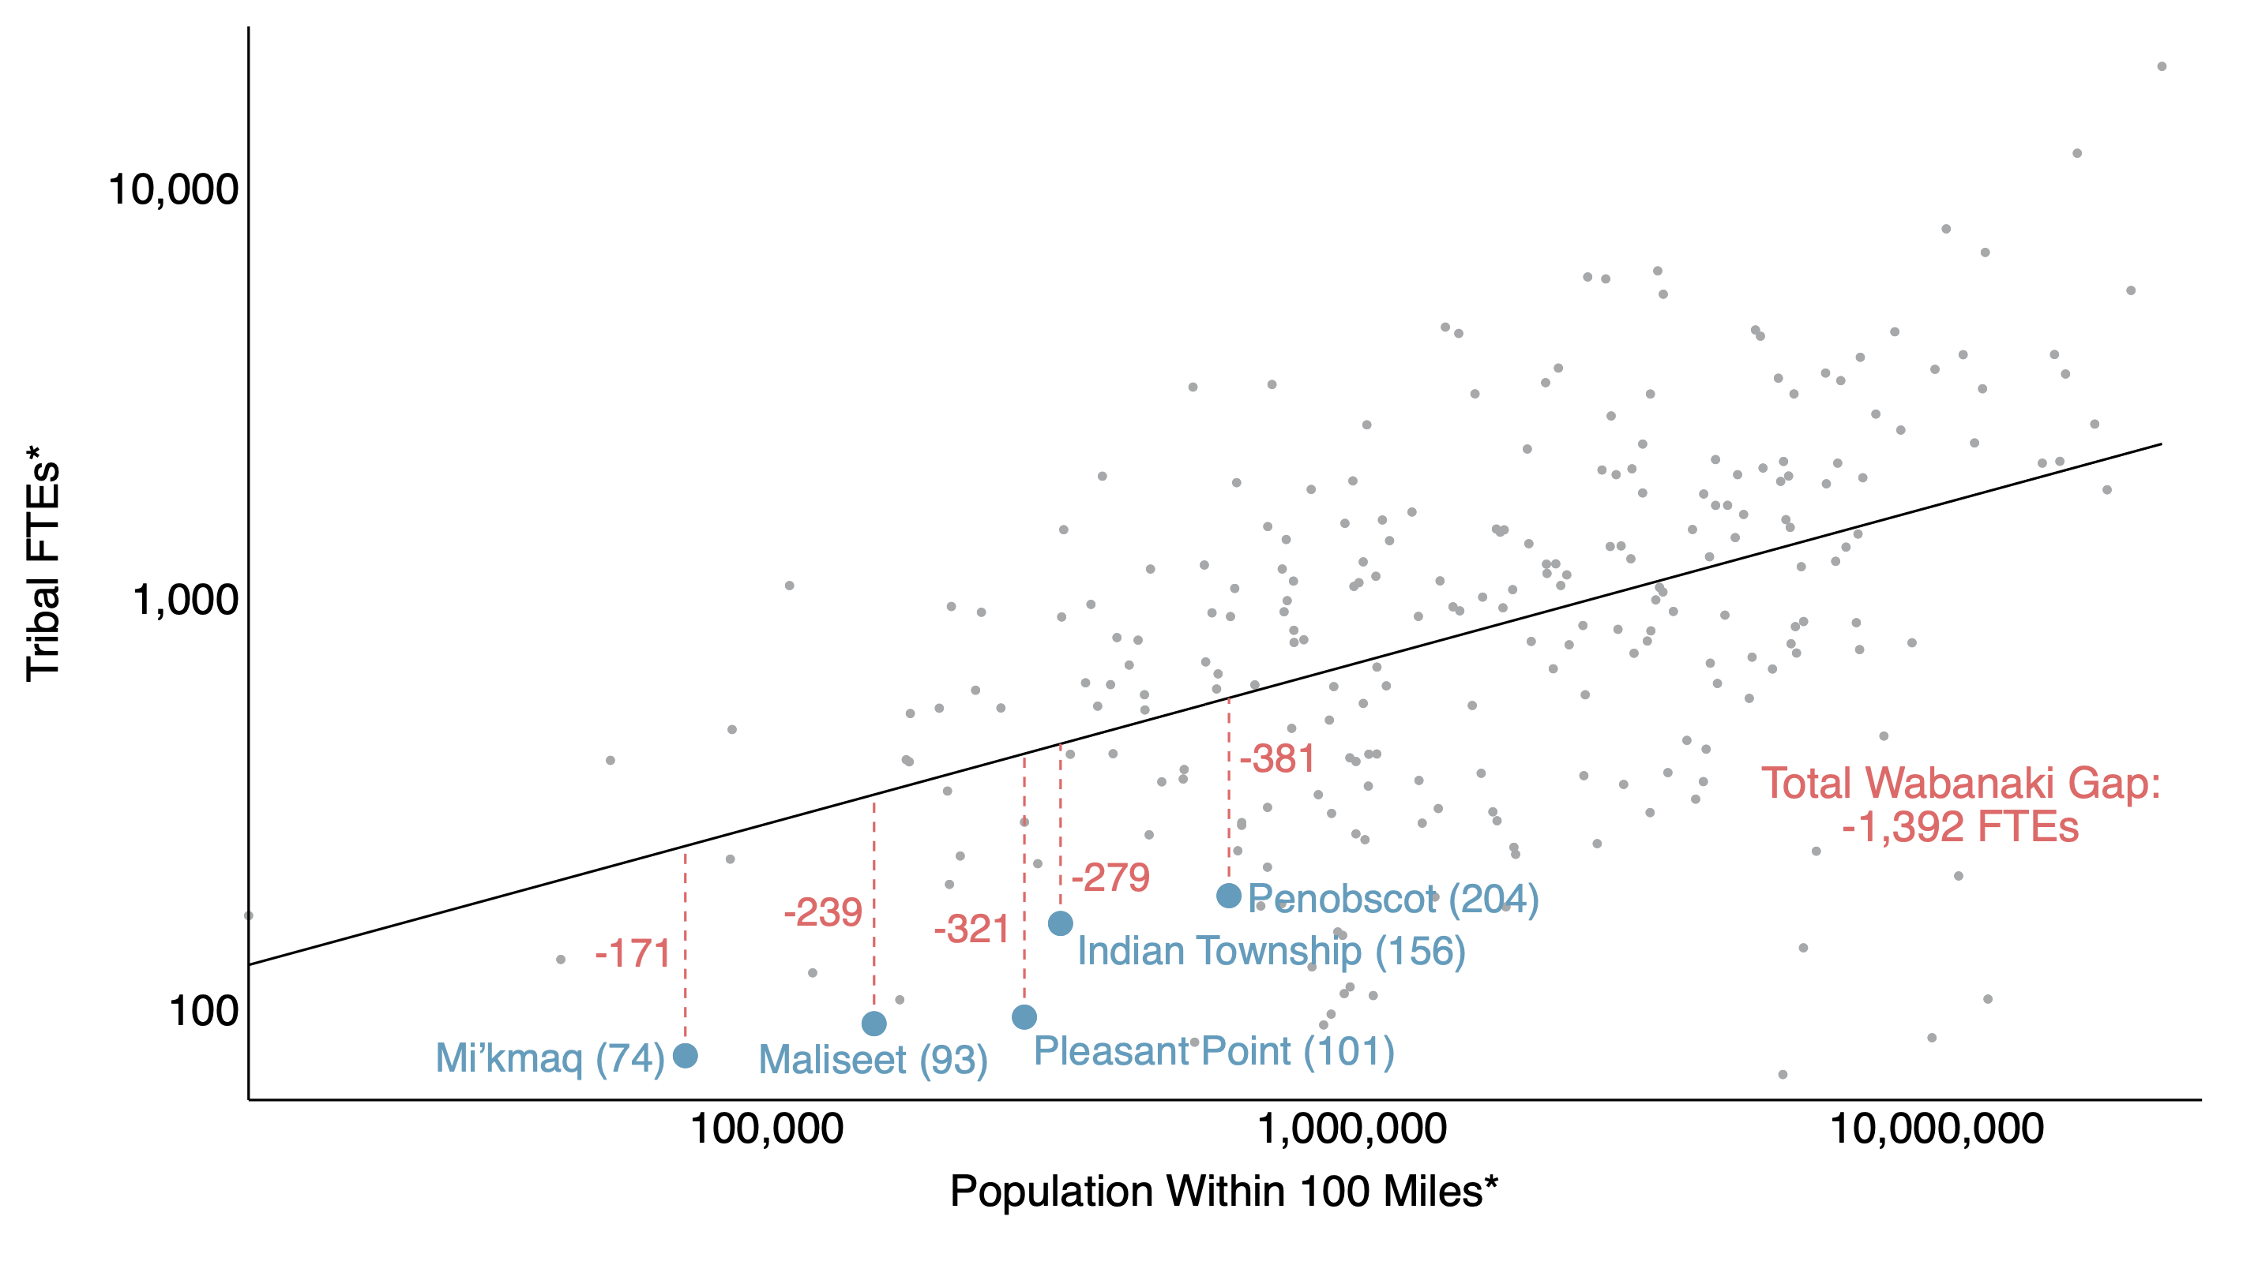
What’s at Stake for Maine in Closing the Wabanaki “Gap”?

Slide 28
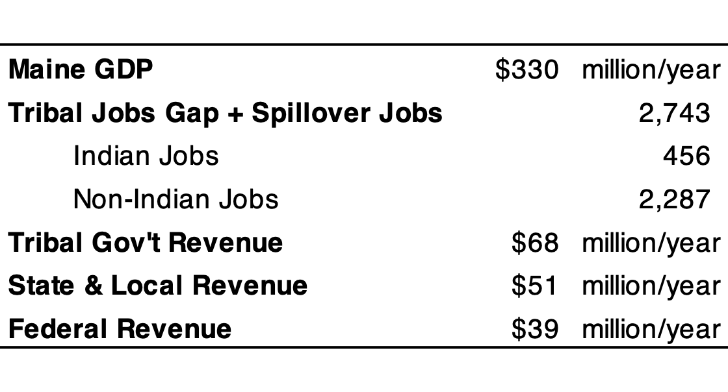
What’s at Stake for Maine in Closing the Wabanaki “Gap”?

Slide 29
How Can Philanthropy Engage Effectively?
It’s all – or almost all – about strengthening tribal capacities of self-government
Challenges in supporting governments
  Inexperienced philanthropies
  Tribal political turnover
  Perpetuating dependence
Strategies that work
  Recognize individuals and organizations in their official capacities
  Invest in institutions of “nation building”
  Utilize issue-limited “block grants”
  Implement performance, rather than process, monitoring and assessment

Slide 30
The Harvard Project on American Indian Economic Development
Thank You
For more information,
visit www.hpaied.org
Kalt, JP, AB Medford, JB Taylor (2022) “Economic and Social Impacts of Restrictions on the Applicability of Federal Indian Policies to the Wabanaki Nations in Maine.”

